Slide 1

Chapter 3 Transport Layer
A note on the use of these PowerPoint slides:
We’re making these slides freely available to all (faculty, students, readers). They’re in PowerPoint form so you see the animations; and can add, modify, and delete slides (including this one) and slide content to suit your needs. They obviously represent a lot of work on our part. In return for use, we only ask the following:
If you use these slides (e.g., in a class) that you mention their source (after all, we’d like people to use our book!)
If you post any slides on a www site, that you note that they are adapted from (or perhaps identical to) our slides, and note our copyright of this material.
For a revision history, see the slide note for this page.
Thanks and enjoy! JFK/KWR
All material copyright 1996-2020
J.F Kurose and K.W. Ross, All Rights Reserved
Computer Networking: A Top-Down Approach 8th edition Jim Kurose, Keith Ross Pearson, 2020
Notes:
Version History
8.0 (April 2020)
All slides reformatted for 16:9 aspect ratio
All slides updated to 8th edition material
Use of Calibri font, rather that Gill Sans MT
Add LOTS more animation throughout
added new 8th edition material on QUIC, CUBIC, delay-based congestion control
lighter header font

Slide 2




Packet-switching: store-and-forward
L bits
per packet
source
3
2
1
destination
R bps
R bps
packet transmission delay: takes L/R seconds to transmit (push out) L-bit packet into link at R bps
One-hop numerical example:
L = 10 Kbits
R = 100 Mbps
one-hop transmission delay = 0.1 msec

Slide 3
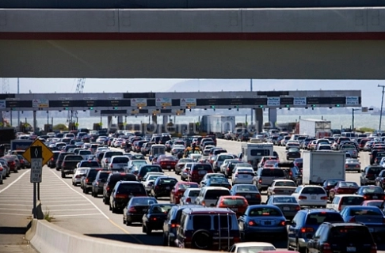
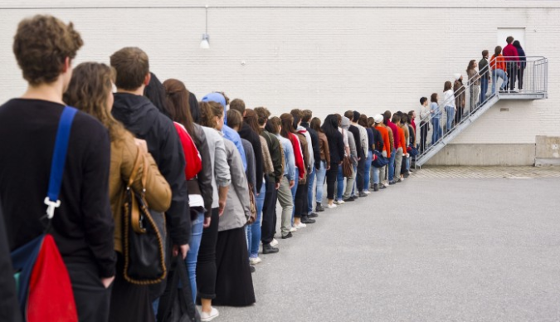
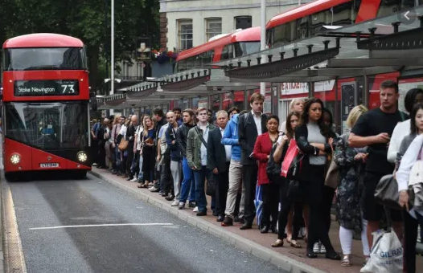
Packet-switching: queueing
A
C
R = 50 Mb/s
R = 50 Mb/s
D
B
R = 50 Mb/s
E
queue of packets
waiting for transmission over output link
Queueing occurs when work arrives faster than it can be serviced:

Slide 4
Packet-switching: queueing
A
C
D
B
E
queue of packets
waiting for transmission over output link
Packet queuing and loss: if arrival rate (in bps) to link exceeds transmission rate (bps) of link for some period of time:
packets will queue, waiting to be transmitted on output link
packets can be dropped (lost) if memory (buffer) in router fills up

Slide 5

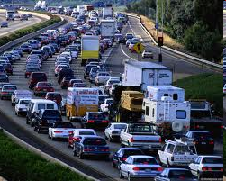
Packet queueing delay (revisited)
a: average packet arrival rate
L: packet length (bits)
R: link bandwidth (bit transmission rate)
average queueing delay
L
a
.
:
arrival rate of bits
“traffic
intensity”
R
service rate of bits
traffic intensity = La/R
1
La/R ~ 0: avg. queueing delay small
La/R -> 1: avg. queueing delay large
La/R > 1: more “work” arriving is more than can be serviced - average delay infinite!
La/R ~ 0
La/R -> 1

Slide 6
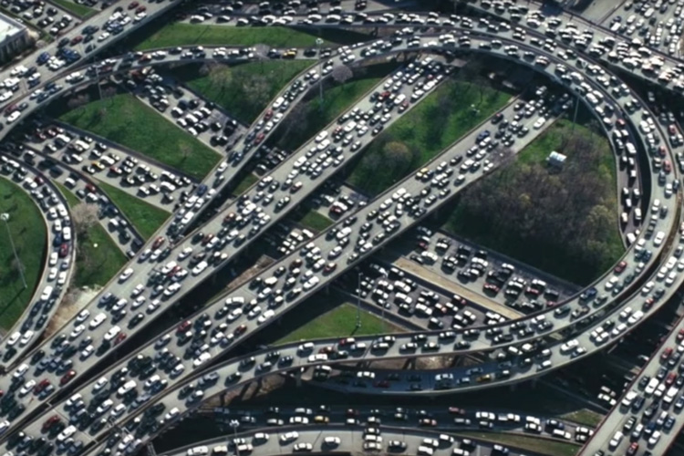


Principles of congestion control
Congestion:
informally: “too many sources sending too much data too fast for network to handle”
manifestations:
long delays (queueing in router buffers)
packet loss (buffer overflow at routers)
different from flow control!
congestion control: too many senders, sending too fast
a top-10 problem!
flow control: one sender too fast for one receiver

Slide 7
Throughput
throughput: rate (bits/time unit) at which bits are being sent from sender to receiver
instantaneous: rate at given point in time
average: rate over longer period of time
link capacity
R_{s} bits/sec
link capacity
R_{c} bits/sec
pipe that can carry
fluid at rate
(R_{s} bits/sec)
pipe that can carry
fluid at rate
(R_{c} bits/sec)
server sends bits
(fluid) into pipe
server, with
file of F bits
to send to client

Slide 8
Throughput
R_{s} < R_{c} What is average end-end throughput?
R_{s} bits/sec
R_{c} bits/sec
R_{s} > R_{c} What is average end-end throughput?
R_{s} bits/sec
R_{c} bits/sec
bottleneck link
link on end-end path that constrains end-end throughput

Slide 9
Throughput: network scenario
per-connection end-end throughput: min(R_{c},R_{s},R/10)
in practice: R_{c} or R_{s} is often bottleneck
R_{s}
R_{s}
R_{s}
R
R_{c}
R_{c}
R_{c}
* Check out the online interactive exercises for more examples: http://gaia.cs.umass.edu/kurose_ross/
10 connections (fairly) share backbone bottleneck link R bits/sec

Slide 10
Causes/costs of congestion: scenario 1
original data: λ_{in}
throughput: λ_{out}
Simplest scenario:
Host A
one router, infinite buffers
input, output link capacity: R
infinite shared output link buffers
two flows
R
R
no retransmissions needed
Host B
R/2
Q: What happens as arrival rate λ_{in} approaches R/2?
λ_{out}
delay
throughput:
λ_{in}
R/2
λ_{in}
R/2
maximum per-connection throughput: R/2
large delays as arrival rate λ_{in} approaches capacity
R/2

Slide 11
Causes/costs of congestion: scenario 2
one router, finite buffers
sender retransmits lost, timed-out packet
application-layer input = application-layer output: λ_{in} = λ_{out}
transport-layer input includes retransmissions : λ’_{in} λ_{in}
Host A
λ_{in} : original data
λ'_{in}: original data, plus retransmitted data
λ_{out}
R
R
Host B
finite shared output link buffers

Slide 12
Causes/costs of congestion: scenario 2
Idealization: perfect knowledge
sender sends only when router buffers available
R/2
λ_{out}
throughput:
Host A
λ_{in} : original data
λ_{in}
copy
λ'_{in}: original data, plus retransmitted data
λ_{out}
R/2
free buffer space!
R
R
Host B
finite shared output link buffers

Slide 13

Causes/costs of congestion: scenario 2
Idealization: some perfect knowledge
packets can be lost (dropped at router) due to full buffers
sender knows when packet has been dropped: only resends if packet known to be lost
Host A
λ_{in} : original data
copy
λ'_{in}: original data, plus retransmitted data
no buffer space!
R
R
Host B
finite shared output link buffers

Slide 14
Causes/costs of congestion: scenario 2
Idealization: some perfect knowledge
packets can be lost (dropped at router) due to full buffers
sender knows when packet has been dropped: only resends if packet known to be lost
R/2
λ_{out}
“wasted” capacity due to retransmissions
when sending at R/2, some packets are needed retransmissions
throughput:
Host A
λ_{in} : original data
λ_{in}
λ'_{in}: original data, plus retransmitted data
R/2
free buffer space!
R
R
Host B
finite shared output link buffers

Slide 15


Causes/costs of congestion: scenario 2
Realistic scenario: un-needed duplicates
packets can be lost, dropped at router due to full buffers – requiring retransmissions
but sender times can time out prematurely, sending two copies, both of which are delivered
R/2
λ_{out}
“wasted” capacity due to un-needed retransmissions
throughput:
when sending at R/2, some packets are retransmissions, including needed and un-needed duplicates, that are delivered!
Host A
λ_{in} : original data
λ_{in}
copy
λ'_{in}: original data, plus retransmitted data
R/2
timeout
free buffer space!
R
R
Host B
finite shared output link buffers

Slide 16
Causes/costs of congestion: scenario 2
Realistic scenario: un-needed duplicates
packets can be lost, dropped at router due to full buffers – requiring retransmissions
but sender timers can time out prematurely, sending two copies, both of which are delivered
R/2
λ_{out}
“wasted” capacity due to un-needed retransmissions
throughput:
when sending at R/2, some packets are retransmissions, including needed and un-needed duplicates, that are delivered!
λ_{in}
R/2
“costs” of congestion:
more work (retransmission) for given receiver throughput
unneeded retransmissions: link carries multiple copies of a packet
decreasing maximum achievable throughput

Slide 17
Causes/costs of congestion: scenario 3
four senders
multi-hop paths
timeout/retransmit
Q: what happens as λ_{in} and λ_{in}’ increase ?
A: as red λ_{in}’ increases, all arriving blue pkts at upper queue are dropped, blue throughput g 0
Host A
λ_{in} : original data
λ'_{in}: original data, plus retransmitted data
Host B
finite shared output link buffers
Host D
λ_{out}
Host C

Slide 18
Causes/costs of congestion: scenario 3
R/2
λ_{out}
λ_{in}’
R/2
another “cost” of congestion:
when packet dropped, any upstream transmission capacity and buffering used for that packet was wasted!

Slide 19
Causes/costs of congestion: insights
throughput can never exceed capacity
delay increases as capacity approached
loss/retransmission decreases effective throughput
un-needed duplicates further decreases effective throughput
upstream transmission capacity / buffering wasted for packets lost downstream

Slide 20
Approaches towards congestion control
End-end congestion control:
no explicit feedback from network
congestion inferred from observed loss, delay
ACKs
data
data
ACKs
approach taken by TCP

Slide 21
Approaches towards congestion control
Network-assisted congestion control:
routers provide direct feedback to sending/receiving hosts with flows passing through congested router
may indicate congestion level or explicitly set sending rate
explicit congestion info
ACKs
data
data
ACKs
TCP ECN, ATM, DECbit protocols

